Slide 1
Building Organizational Capacity to Create Community Change
Paula Feathers, MA

Slide 2
Work Agreement

Slide 3
Assessment
Place your sticker on the response that best matches your experience.

Slide 4
Capacity Report

Slide 5
Break Time
Please return in 15 minutes

Slide 6
Cultural Awareness in Capacity Building
Behaviors + Attitudes + Policies =
Effectiveness in cross-cultural situations
Race/Ethnicity
Language
Gender
Disability
Sexual Orientation
Socioeconomic status

Slide 7
Seven Domains of Cultural Competence
Organizational values
Governance
Planning, monitoring, evaluation
Communication
Staff Development
Organizational Infrastructure
Services, intervention

Slide 8
CC Activity
Break into 7 groups (domains)
As a group identify the critical areas of your domain.
“Critical” being required skills, knowledge, processes, practices, policies, or __________
Record your answers on flip chart.

Slide 9
CC Activity
As we hear each group report out, please identify 1 action or activity for each domain that you believe your organization could benefit from.

Slide 10
Sustainability

Slide 11
Defining Sustainability
A process of ensuring an adaptive and effective system that achieves and maintains desired long term results.
Ultimately, sustainability is about maintaining positive outcomes in communities.
Sustainability is never achieved, it is a continuous process.

Slide 12
Background
Developed by the SECAPT
Based on extensive literature review (over 100 articles, book chapters, and books).
Literature review was multidisciplinary and includes: Community Development, Community Psychology, Communications, Education, Family Planning, Health Promotion, Management, Mental Health, and Substance Abuse.
Core components essential for sustaining prevention efforts were identified and put into 3 keys.

Slide 13
Sustainability Activity
Using pg. 9-15 answer the following questions in your small group. Be specific as possible in your answers:
What are the 3 main components of sustainability?
There are 10 actions. What do all the activities below the actions provide?

Slide 14
Individual Reflection
Identify 1 sustainability action area (Actions 1-10) your organization needs to further develop or strengthen.
Record your answer.

Slide 15
Capacity
Intervening Variables and Contributing Factors

Slide 16
Prevention as a System
A system is:
Any organized assembly of resources and procedures united and regulated by interaction or interdependence to accomplish a set of specific functions.
A collection of personnel, equipment, and methods organized to accomplish a set of specific functions.

Slide 17
What is capacity?
The conditions needed to support successful community mobilization around a particular problem (Goodman et al., 1998).
The ability of individuals, organizations, and leaders to effectively promote positive initiatives and accomplishments as well as address community problems/priority areas.

Slide 18
What does capacity building consist of?
Training
Committed Staff
Convening key stakeholders, coalitions, and service providers to plan and implement sustainable prevention efforts
Mobilization of resources within a geographic area.
Financial and organizational resources
Forming partnerships
Supportive leadership
Face to face meetings
Town Hall meetings
Parent workshops
Collective activism
Individual activism

Slide 19
Using your goal, identify resources (both internal and external) actively involved for each Contributing Factor for 1 of your Intervening Variables.
Refer to Appendix F and G for possible ideas.
At the same time…

Slide 20
As you identify resources, you may also identify gaps.
Record your gaps on pg. 19

Slide 21
Individual Reflection
What does capacity building mean for this grant?

Slide 22
Strengths, Weaknesses, Opportunities, Threats
SWOT Analysis

Slide 23
SWOT
With a partner study pg. 26 and 27.
Make as much sense as possible out of these 2 pgs.
Place ? next to information you don’t understand.

Slide 24
SWOT
With your community develop a plan listing activities, dates, and assignments for your organization to conduct a SWOT.

Slide 25
Break Time
Please return in 15 minutes

Slide 26
Community Readiness

Slide 27
Listening Teams
Assignments:
Questioners: after lecture ask at least 2 questions about the lecture material.
Agreers: tell which points your team agreed with (or found helpful) and explain why.
Nay Sayers: comments on points you disagreed with (or found unhelpful) and explain why.
Example Givers: explain specific examples or applications of the lecture material.

Slide 28
Listening Teams
I will do an overview of Community Readiness. Your job is to listen to the material presented based on your assignment.
When the overview is finished, you will have a few minutes to meet with your team and complete your assignments as a group.
We will discuss your assignment as a group.

Slide 29
Community Readiness
Readiness is the degree to which a community is prepared to take action on an issue.
The capacity of a community to implement programs, policies and other changes that are designed to reduce the likelihood of substance use. (Plested et.al. (2004). Community Readiness: A Handbook for Successful Change. Tri-Ethnic Center for Prevention Research.)

Slide 30
Community Readiness
Tri-Ethnic Center for Prevention Research model.
Interviewed key community leaders/stakeholders about your goal
Model produced an overall score in addition to a score in 6 dimensions.

Slide 31
Benefits of knowing your community’s readiness
Builds cooperation & collaboration among systems and individuals.
Increases capacity
Encourages and enhances community investment on an issue.
Guides the community through the complex process of community change.
Source: Plested et.al. (2004). Community Readiness: A Handbook for Successful Change. Tri-Ethnic Center for Prevention Research. p.3

Slide 32
Dimensions of Readiness
Community Efforts
Community knowledge of the Efforts.
Leadership
Community climate
Community knowledge of the issue
Resources related to the issue

Slide 33
1
No Awareness
2
Denial/Resistance
3
Vague Awareness
5
Pre-paration
6
Initiation
9
High level of community ownership
7
Stabiliz-ation
8
Confirm-ation/
Expansion
4
Pre-planning
9 Stages of Readiness
Source: Plested et.al. (2004). Community Readiness: A Handbook for Successful Change. Tri-Ethnic Center for Prevention Research. p.9

Slide 34
Community Readiness
Read the CR book
Review and revise the interview questions based on your goal and contributing factors
Identify 6 individuals from different sectors to interview
Review scoring process and prepare for scoring
Interviews
Scoring
Major tasks to plan for

Slide 35
Community Readiness Scoring
 | Interviews | #1 | #2 | #3 | #4 | #5 | #6 | Total
DIMENSIONS | A) Community Efforts | 3.5 | 5.0 | 4.25 | 4.75 | 5.5 | 3.75 | 26.75
 | B) Community Knowledge of Efforts | 2 | 4 | 6 | 3.25 | 4.5 | 3.25 | 23
 | C) Leadership | 2.25 | 4.5 | 4.75 | 3.5 | 4 | 4.25 | 23.25
 | D) Community Climate | 4.25 | 3.75 | 5.0 | 2.75 | 4.5 | 3.5 | 23.75
 | E) Community Knowledge about issue | 4 | 4.25 | 3.75 | 4.5 | 5 | 3.5 | 24.5
 | F) Resources related to issue | 2.75 | 3 | 3.25 | 3.5 | 3.25 | 3 | 18.75

Slide 36
Community Readiness Scoring
Total Dimension |  | Divided by # interviews | Score
Community efforts | 26.75 | 6 | 4.46
Community knowledge of efforts | 23 | 6 | 3.83
Leadership | 23.25 | 6 | 3.88
Community climate | 23.75 | 6 | 3.96
Community knowledge about issue | 24.5 | 6 | 4.08
Resources related to issue | 18.75 | 6 | 3.13
Overall Stage of Readiness Score
Total of all dimensions | Divided by # interviews | Score
23.34 | 6 | 3.89

Slide 37
Listening Teams
Assignments:
Questioners: after lecture ask at least 2 questions about the lecture material.
Agreers: tell which points your team agreed with (or found helpful) and explain why.
Nay Sayers: comments on points you disagreed with (or found unhelpful) and explain why.
Example Givers: explain specific examples or applications of the lecture material.

Slide 38
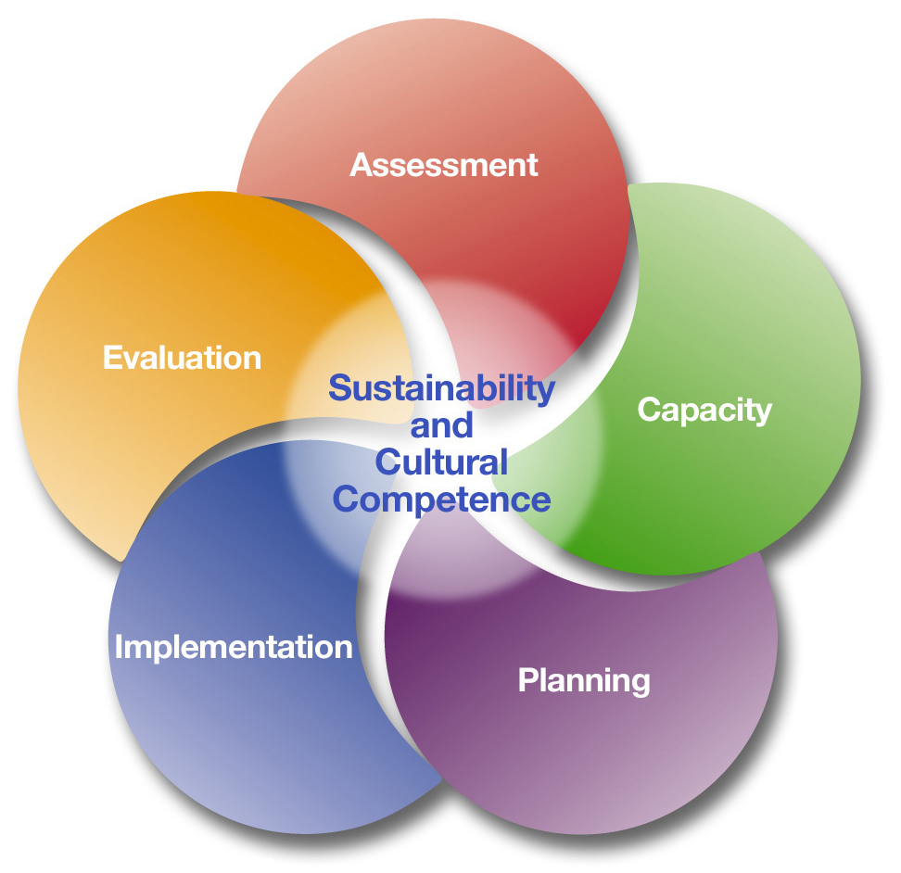
What questions do you have?

